Slide 1
Chapter 17 (TCDS)
Coping With System Failures
Sukarna Barua
Associate Professor, CSE, BUET

Slide 2
Failure Modes
Many things can go wrong:
Erroneous data entry
Media failures
Catastrophic failures

Slide 3
Erroneous Data Entry
Erroneous data entry
Mistype one digit of your phone number
-Impossible to detect the error
Omits a digit from the phone number
-This can be addressed through constraints and triggers
-Can also be addressed from application front end and back end

Slide 4
Media failures
Media failures:
Local failure of a disk such as a bit or a few bit
-Detectable through parity checks
Head crashes where entire disk becomes unreadable
-RAID can be used to restore data
-Archiving data, a copy of the database on tape or optical disk.
-Archive is periodically created
-Full archive
-Incremental archive
-Archive stored at a safe location
-Online redundant copies of database distributed among several sites

Slide 5
Catastrophic Failures
Catastrophic Failures:
Data storage media destroyed completely
Events: Explosions, fires, or vandalisms
Protection:
- RAID will not help. Why?
-Archived copies can be used to restore lost data
-Online redundant copies can restore lost data

Slide 6
System failures
Example of system failures: Memory failure, power failure, operation system failure during the runtime of the database software
A transaction in a database executes a number of steps to modify/update database state. [Credit Account A, Debit Account B]
System failures can cause a transaction to fail at an intermediate state. [Fails after Credit Account A]
This puts database in an inconsistent state. [Account A credited, Account B is not debited]
Protect from system failure:
Logging all database changes
In case of failure, exact changes done may be reversed and reapplied

Slide 7
What is a transaction?
Unit of execution of database operations.
Starts when a session is created with a database.
Each query is part of an ongoing transaction
Transactions ends when COMMIT or ROLLBACK ("abort") commands are issued.
A new transaction starts after COMMIT or ROLLBACK.

Slide 8
Atomicity of Transactions
Atomicity of Transactions:
A transaction must execute fully or nothing. This is called atomicity.
Remember the transaction: Credit Account A, Debit Account B.
Either both operations execute or neither operations execute to keep database in a consistent state
If one executes, but not the other, then database state is inconsistent.
Transaction manager ensures all transactions execute "atomically"

Slide 9
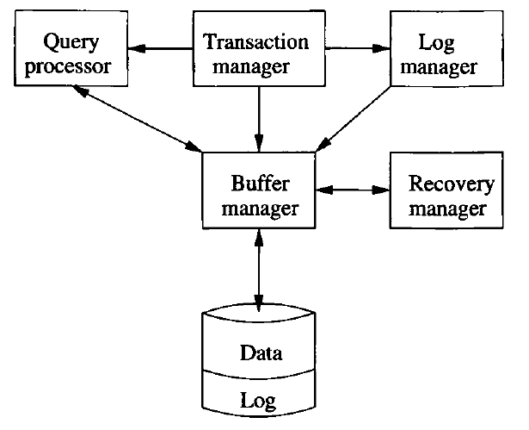
Transaction Manager
Transaction Manager
Ensures atomicity of database transactions.
Interacts with query processor to execute queries
in a transaction
Interacts with log manager to keep log records
Assure that no two transactions interfere with one another
Log manager:
Maintains log records
Logs are initially stored in buffers and sent to disk
when needed
Recovery manager:
Recovers data during crash events.
Examines log records and repair data

Slide 10
Transaction Manager
Transaction Manager
Ensures atomicity of database transactions.
Interacts with query processor to execute queries
in a transaction
Interacts with log manager to keep log records
Assure that no two transactions interfere with one another
Log manager:
Maintains log records
Logs are initially stored in buffers and sent to disk
when needed
Recovery manager:
Recovers data during crash events.
Examines log records and repair data
Buffer manager:
Manager memory buffers and their read/write from/to disk

Slide 11
Database State
Database elements: Relations, disk blokes, tuples, etc.
Database state: A database has a state consisting of values of its elements.
Consistent state:
Consistent states satisfy –
All explicit database constraints
Implicit constraints defined by triggers, and
Implicit constraints that are minds of the database designer.
Implicit constraints are hard to enforce using database constraints such as check, primary key foreign key, etc.
Remember the example: Credit and debit must happen together. This is an implied business logic constraints.

Slide 12
Correctness Principle
Correctness Principle:
If a transaction executes in the absence of any other transactions or system failures, and it starts with the database in a consistent state, then the database is also in consistent state when the transaction ends.

Slide 13
Converse to Correctness Principle
Converse to Correctness Principle
If part of a transaction executes, then database state become inconsistent.
A transaction is atomic; it must be executed as a whole or not at all.
Transactions that execute simultaneously are likely to lead to an inconsistent state
Need to take steps to control interactions of different transactions

Slide 14
Read and Write of Database Elements
A transaction reads a database element (e.g., a disk block) as follows:
Loads the elements from disk block to memory buffer
Updates values of the elements in the buffer
Buffer will be written to disk
May or may not happen immediately [decided by buffer manager]
In order to reduce number of disk I/Os, copying updated buffers to disk may happen delayed.

Slide 15
Primitive Operations for Read/Write
Assume X is a database block.
INPUT(X): Copy disk block X to memory buffer.
READ(X,t): Copy disk block X to transaction's local variable t.
If X is not in memory buffer, then INPUT(X) is executed before READ(X,t).
WRITE(X,t): Copy updated value of t to memory buffer X.
If X is not in memory buffer, INPUT(X) needs to be executed.
OUTPUT(X): Copy X from memory to disk.

Slide 16
Primitive Operations for Read/Write
Assume X is a database block.
INPUT(X): Copy disk block X to memory buffer.
READ(X,t): Copy disk block X to transaction's local variable t.
If X is not in memory buffer, then INPUT(X) is executed before READ(X,t).
WRITE(X,t): Copy updated value of t to memory buffer X.
If X is not in memory buffer, INPUT(X) needs to be executed.
OUTPUT(X): Copy X from memory to disk.
READ and WRITE are usually issued by transaction manager
INPUT and OUTPUT are usually issued by buffer manager

Slide 17
Transactions in Primitive Steps
Assume a transaction T consists of following two steps:
A := A*2
B := B*2
Say before T executes, A=B.
After T executes, A=B should be satisfied; otherwise database is not consistent.
Transaction T can be broken down into primitive database steps as follows:
READ(A,t); t := t*2; WRITE(A,t); READ(B,t); t := t*2; WRITE(B,t);
After T ends, buffer manager issues OUTPUT(A) and OUTPUT(B)

Slide 18
Transactions in Primitive Steps
Assume a transaction T consists of following two steps:
A := A*2
B := B*2
Say before T executes, A=B.
After T executes, A=B should be satisfied; otherwise database is not consistent.
Transaction T can be broken down into primitive database steps as follows:
READ(A,t); t := t*2; WRITE(A,t); READ(B,t); t := t*2; WRITE(B,t);
After T ends, buffer manager issues following commands:
INPUT(A), INPUT(B) before READ(A,t)
OUTPUT(A) and OUTPUT(B) after transaction ends.

Slide 19
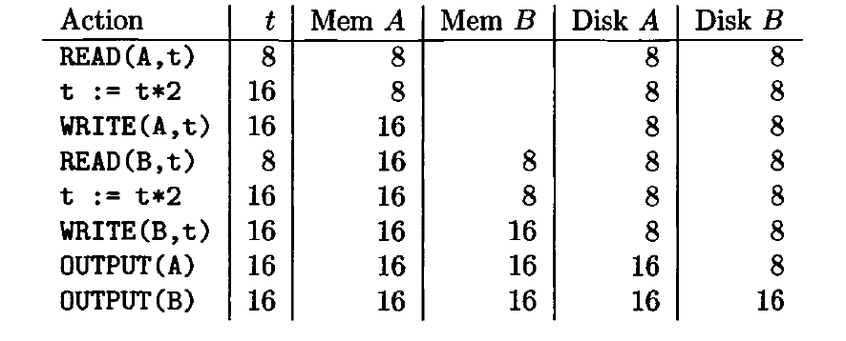
Transactions in Primitive Steps
Assume A=B=t before the transaction.
What happens if system crashes before OUTPUT(A)?
Database is consistent as if T never executed
What happens if system crashes before OUTPUT(B)?
Database is in inconsistent state

Slide 20
Log Manager: Log Records
Log manager:
Maintains log records
Logs are initially stored in buffers and sent to disk when needed
Helps maintaining consistent database state
What is a log record?
A log records stores what the transaction has done
Stored in non-volatile storage (e.g, disk).
Can be used to recover database from crash.
Log records are initially written to log blocks (memory buffers allocated for logs)
Log blocks are written to disk when feasible

Slide 21
Types of Log Records
<START T>: Transaction T has begun
<COMMIT T>: Transaction has completed successfully.
Any changes made by T must be stored in disk.
What happens if buffers are not copied to disk?
Log manager ensures changes will be reflected.
<ABORT T>: Transaction T has not completed successfully. Any changes made by T must not be stored in disk.
What if buffer manager writes updated buffers to disk?
Log manager ensures changes will not be reflected.
Delayed write may be used to reduce disk I/O

Slide 22
Types of Log Records
<T,X,v>: Transaction T has changed element X whose previous value was v.
Changes normally occur in memory buffers first.
This log record is used by “Undo Logging” mechanism
This log record is a response to WRITE(X,t) not OUTPUT(X).
New value of X is not stored in log records for undo logging.
Why? [we shall see soon]
<T,X,v>: Transaction T has changed element X whose new value is v.
This log record is used by “Redo Logging” mechanism
Old value of X is not stored in log records for redo logging.
Why? [we shall see soon]

Slide 23
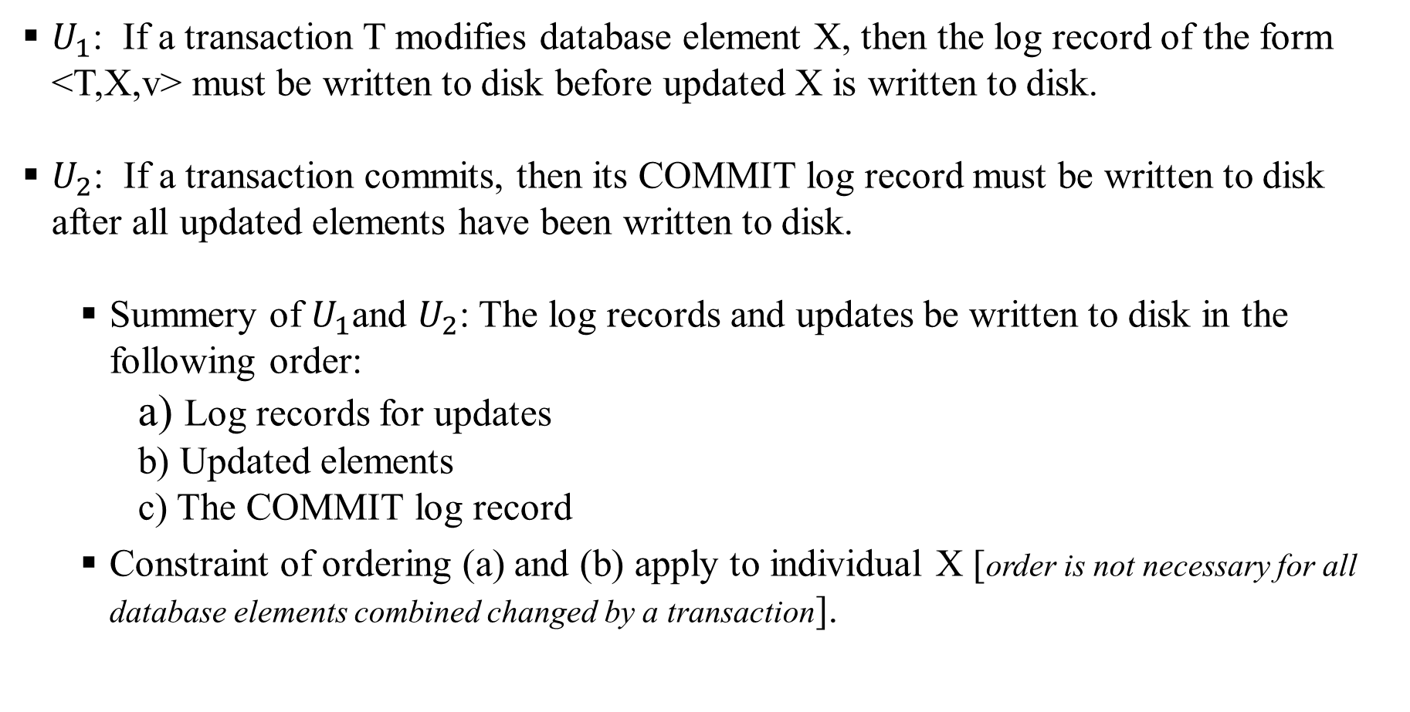
Undo Logging: Rules
$U_{1}$: If a transaction T modifies database element X, then the log record of the form <T,X,v> must be written to disk before updated X is written to disk.
$U_{2}$: If a transaction commits, then its COMMIT log record must be written to disk after all updated elements have been written to disk.
Summery of $U_{1}$and $U_{2}$: The log records and updates be written to disk in the following order:
a) Log records for updates
b) Updated elements
c) The COMMIT log record
Constraint of ordering (a) and (b) apply to individual X [order is not necessary for all database elements combined changed by a transaction].

Slide 24
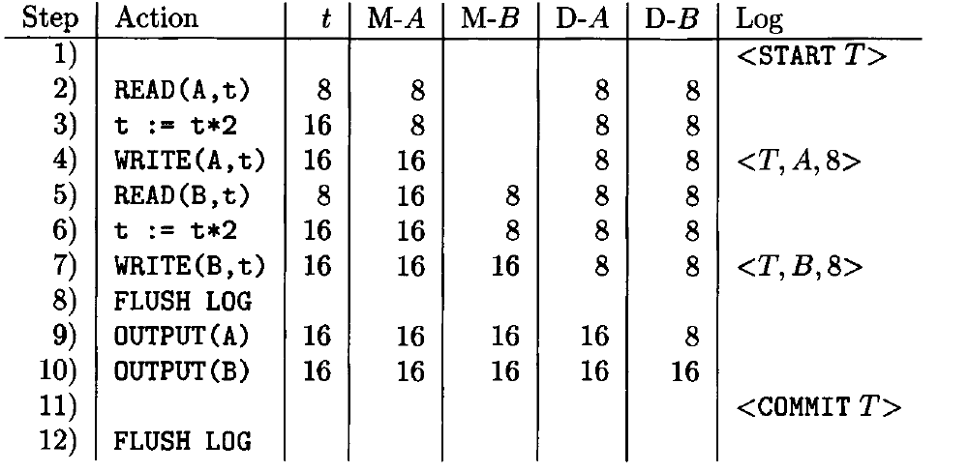
Undo Logging: Rules
Consider the transaction and log record processing:
(1) <START T> is written to log.
(4) <T,B,8> is written to log.
(7) <T,B,8> is written to log.
(8) FLUSH LOG flushes logs to the disk
(9-10) Updated A and B are written to disk.
(11) <COMMIT T> written to log.
(12) FLUSH LOG flushes <COMMIT T>
log record to disk.
Note that before writing <COMMIT T> log record to disk, updated A and B must be written to disk [Undo logging policy]

Slide 25
Commit of Transactions
What does it mean when a transaction is successful?
COMMIT/ABORT record have been written to log and flushed to disk.
User is confirmed of transaction completion (commit/abort).
This is known as synchronous commit protocol.
Prevents data loss during system crash. [How?]
What is COMMIT/ABORT have written to log memory only?
User is confirmed of transaction completion (commit/abort).
COMMIT is only written to memory log but not reflected on disk.
This is known as asynchronous commit.
Data loss can happen due to system crash. [How?]
In both cases, database remains consistent. [How?]

Slide 26
Recovery Using Undo Logging
Suppose a system failure occurs during a running transaction T.
Problem: Some changes written to disk but some were not.
Transaction did not completed.
All partial changes (reflected on disk) need to be reversed.
Solution: Recover manager uses log records to revert the partial changes reflected by T.
After all partial changes are reversed, database returns to a consistent state.

Slide 27
Recovery Using Undo Logging
Step 1: Recovery manager decides whether a transaction T has committed or not.
Step 2a: T is a committed transaction:
If there is a <COMMIT T> log record in disk for transaction T, then T is considered as committed.
According to "Undo Logging" policy all updates have been written to disk.
T have not left database in inconsistent state.
No need to do anything for committed transaction by the recovery manager.

Slide 28
Recovery Using Undo Logging
Step 2b: T is an uncommitted transaction:
If there is <START T> but no <COMMIT T> log record in disk for transaction T.
T is considered as uncommitted (aborted).
However, some updates may have been written to disk.
T is an incomplete transaction and may have left database in inconsistent state.
Recovery manager checks all log records of the form <T,X,v>
“Undo Logging” policy ensures that if updated X were written to disk, then <T,X,v> log record was also written to disk.
Recovery manager reverts the value of elements X to old value v.
Restores database in consistent state

Slide 29
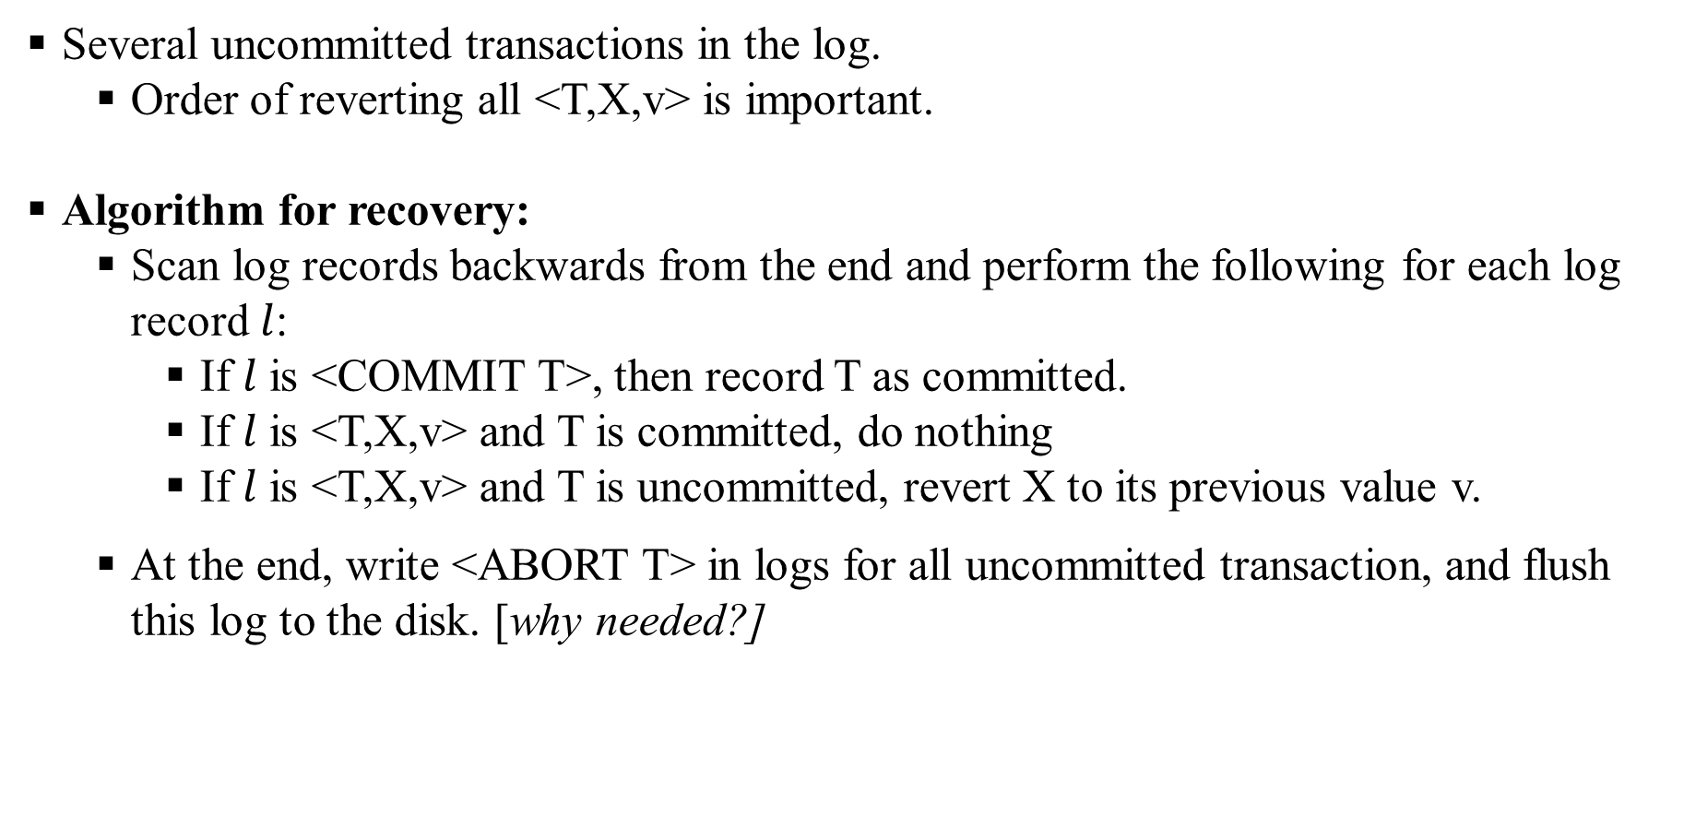
Recovery Manager Operation
Several uncommitted transactions in the log.
Order of reverting all <T,X,v> is important.
Algorithm for recovery:
Scan log records backwards from the end and perform the following for each log record$l$:
If $l$ is <COMMIT T>, then record T as committed.
If $l$ is <T,X,v> and T is committed, do nothing
If $l$ is <T,X,v> and T is uncommitted, revert X to its previous value v.
At the end, write <ABORT T> in logs for all uncommitted transaction, and flush this log to the disk. [why needed?]

Slide 30
Crashes During Recovery
What happens if system crashes again during recovery?
Recovery operation is idempotent.
Remember <T,X,v> reverts X to its prevous value v. What if it is done multiple times?
Same effect as if done once.
It does not matter the current value of X while rewriting v, we just write.
Recovery operation can be repeated multiple times and results are same.
Thus, if system crashes again during recovery, recovery process can be started again.

Slide 31
Recovery Manager Operation
Analyze recover manager operation for the following cases:
System crashes after step 12.
Stem crashes before step 11.
System crashes before step 6.
System crashes before step 4.

Slide 32
Checkpointing
Log records can become very large.
Difficult to scan full log records after a system crash.
Use checkpointing mechanism:
Log records before checkpoint need not be examined during recovery
All transactions before the checkpoint must have COMMIT or ABORT record on the log.

Slide 33
Checkpointing
Checkpointing Algorithm:
Step 1: Stop accepting new transactions.
Step 2: Wait until all active transactions commit or abort.
Step 3: Flush the logs to the disk.
Step 4: Write a log record <CKPT> and flush this log to disk.
Step 5: Resume accepting new transactions.
At system failure, recovery manager only needs to examine log records up to a <CKPT> point.
All transactions before <CKPT> have a COMMIT or ABORT for corresponding transaction in the disk.
COMMIT or ABORT ensures transaction reflected successfully in database

Slide 34
Nonquiescent Checkpointing
Problem with normal checkpointing:
All new transactions must wait until all existing transactions complete.
Effectively shuts down the database for a long time if some active transactions take a long time to complete
Solution: Nonquiescent checkpointing
Algorithm for nonquiescent checkpointing:
Step 1: Write a log record <START CKPT(T1,T2,..,TK)> and flush the logs. T1,T2,..,TK are all active transactions.
Step 2: Wait until T1,T2,..,TK finish. But don't prohibit new transactions from starting.
Step 3: When T1,T2,..,TK finishes, write a log record <END CKPT> and flush the logs.

Slide 35
Recovery With Nonquiescent Checkpointing
Recovery process algorithm:
Recover manager scans log records backward from the end
Processes log records as like before reverting changes if necessary.
Following two cases are considered for stopping scan of log records:
Case 1: If it finds an <END CKPT>, then all incomplete transactions began after <START CKPT(T1,T2,..,TK). So scanning can stop when <START CKPT> is encountered.
Case 2: If it finds <START CKPT(T1,T2,..Tk), then it knowns only T1,T2,..TK were active. So scan can stop at the earliest <START> record of T1,T2,..TK.

